Slide 1



SOFTWARE DEVELOPMENT PROFESSIONAL PROGRAM
The Document Object Model

Slide 2





The Document Object Model
Learning Objectives
Define DOM.
Select an element from an HTML page using JavaScript.
Change an element's styles.

Slide 3

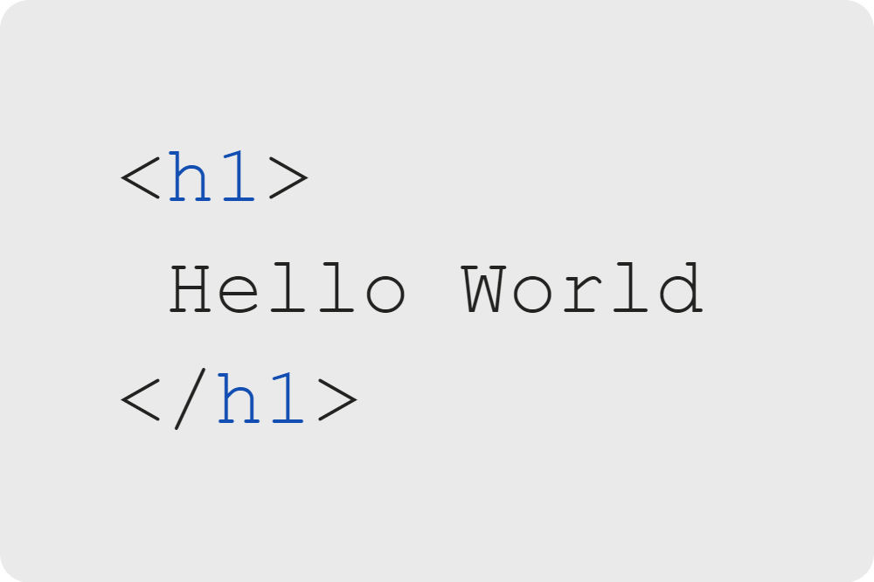
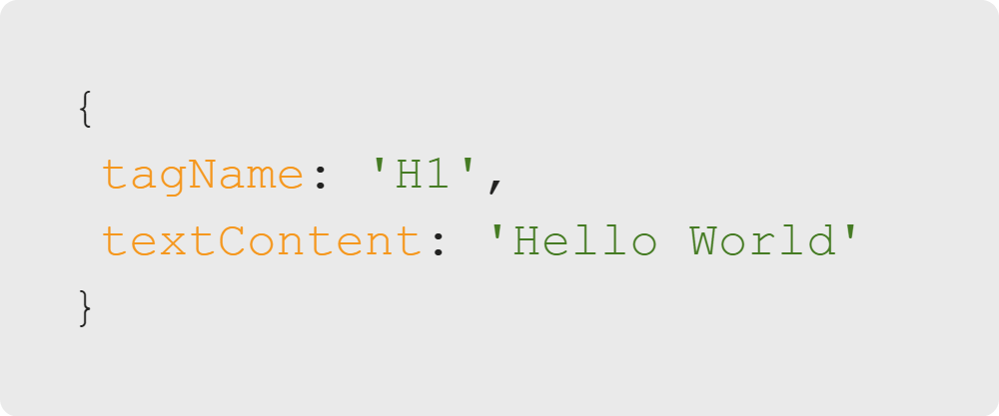
The Document Object Model
Discussion: Expressing UI
Notes:
What do these two pieces of code have in common? In what ways are they different?
1. These two pieces of code describe the same data.
2. They describe the data in different ways.
UI stands for User Interface. UI is used in this context to describe how a user interacts with the page.

Slide 4


The Document Object Model
Question: Expressing UI
Notes:
1. It is a JavaScript object.
2. It describes an HTML element.

Slide 5



The Document Object Model
HTML and the DOM
HTML
The Browser
The DOM
Notes:
The browser takes in HTML and creates a JavaScript object that represents it.
The object is called 'The DOM.'

Slide 6


The Document Object Model
The DOM
Document
Object
Model
Notes:
The DOM is the browser's interpretation of your HTML code. It is resturctured
into JS objects that the browser can render, and which you can then edit using JS.
<<Exercise 01--what does DOM stand for?>>

Slide 7

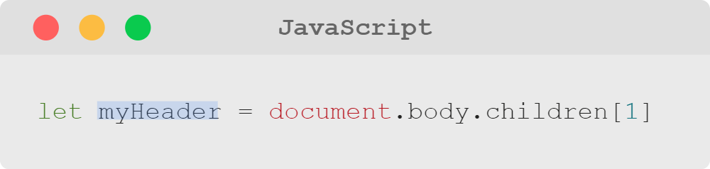
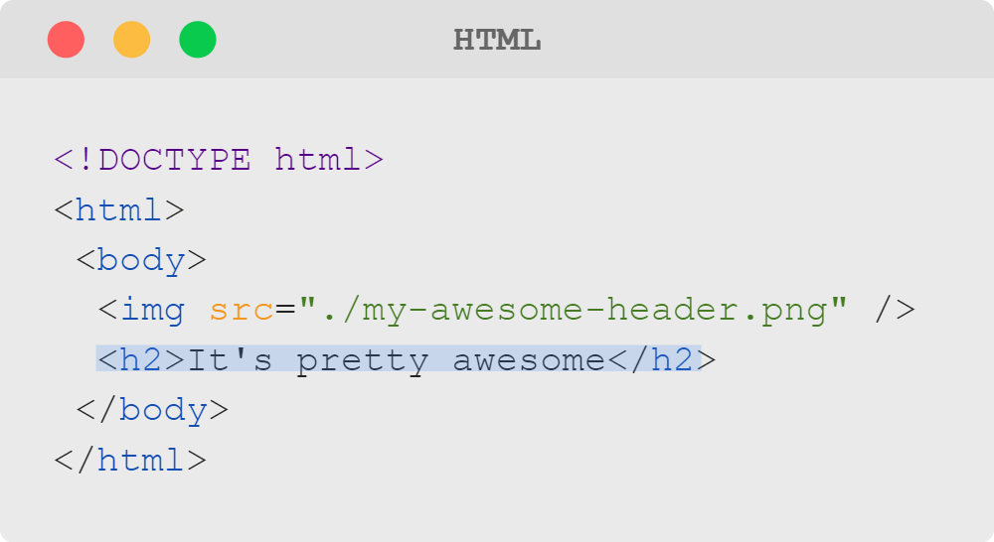
The Document Object Model
Traversing the DOM
The DOM is a global variable named "document."
It is a big, nested object that represents all HTML elements displayed in the browser and their properties.
We can get to specific elements in the DOM using '.' and '[ ]'.
Notes:
It may help you to think of it like this:
The DOM is an OBJECT that MODELS (represents) the HTML DOCUMENT and can be accessed by any scripting language
like JavaScript.
Take a look here at how we are accessing *index 1* of the *children* of the *body element*.
You can use the data and methods of the DOM to change what the user sees with JavaScript.
<<Exercise 02--qualities of the DOM>>

Slide 8
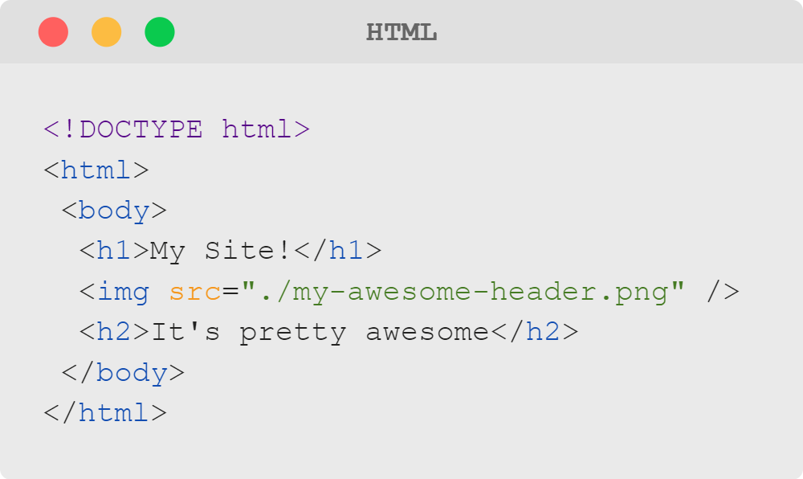
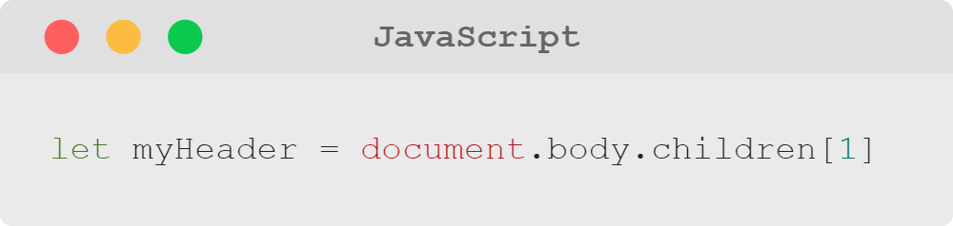
The Document Object Model
Question
What would myHeader be now?
Notes:
What would happen if we later added another element to the HTML?

Slide 9
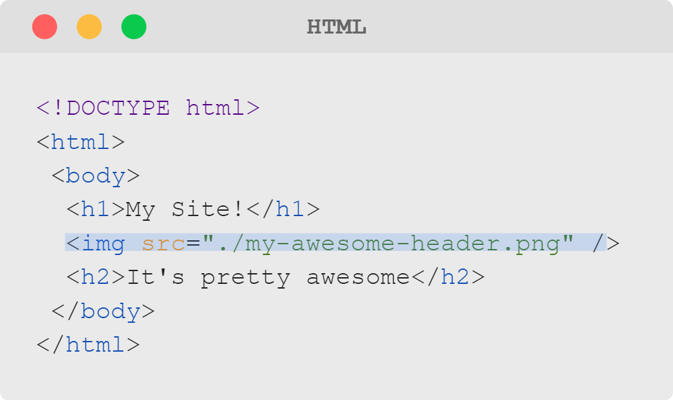
The Document Object Model
Answer
Now myHeader is actually the image.
Notes:
Traversing the DOM manually would be both tedious and brittle (prone to break often).

Slide 10


The Document Object Model
Familiar Syntax: querySelector
A method on document
Takes in a CSS selector
Returns a DOM element
Notes:
Instead, we can select elements the way we do with CSS, using a built-in function called "querySelector."

Slide 11
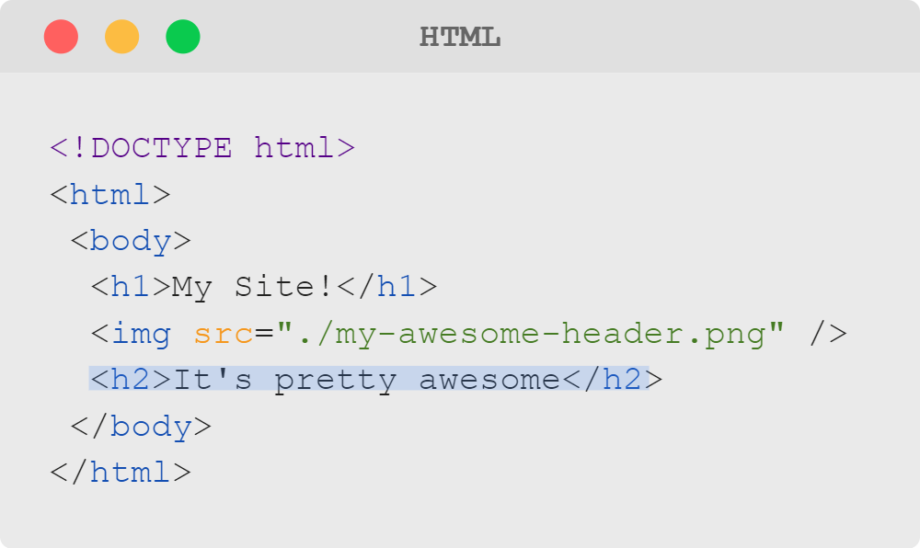
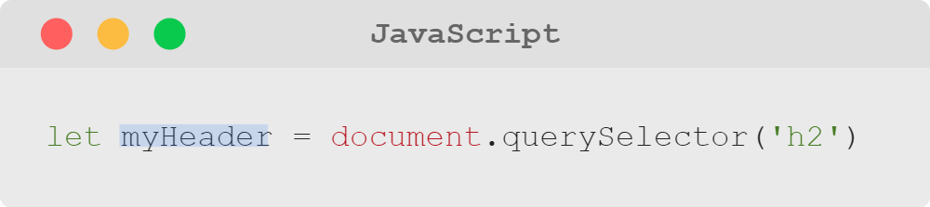
The Document Object Model
Selecting by Tag Name
Notes:
Using querySelector, you can select elements by the tag name...
<<Exercise 03--select an HTML element using "querySelector" and a tag name>>

Slide 12
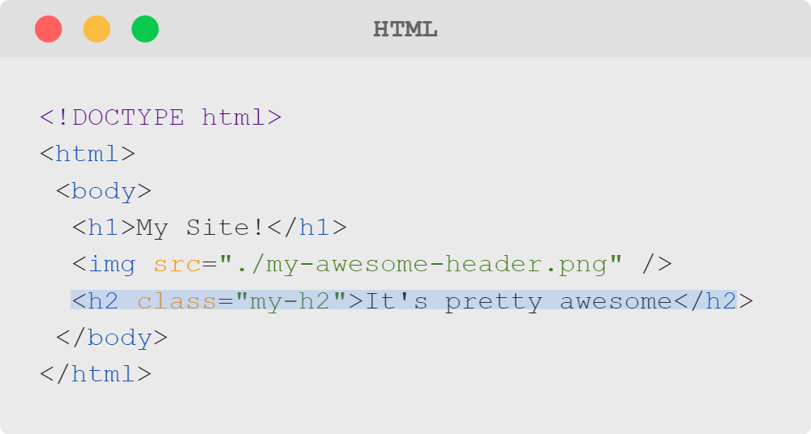
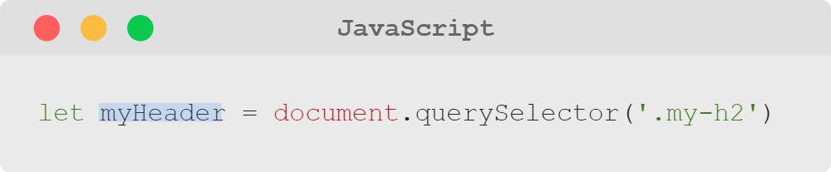
The Document Object Model
Selecting by Class
Notes:
Or by class, using the '.' just like you would in CSS.
<<Exercise 04--select an html element using "querySelector" and a class name>>

Slide 13
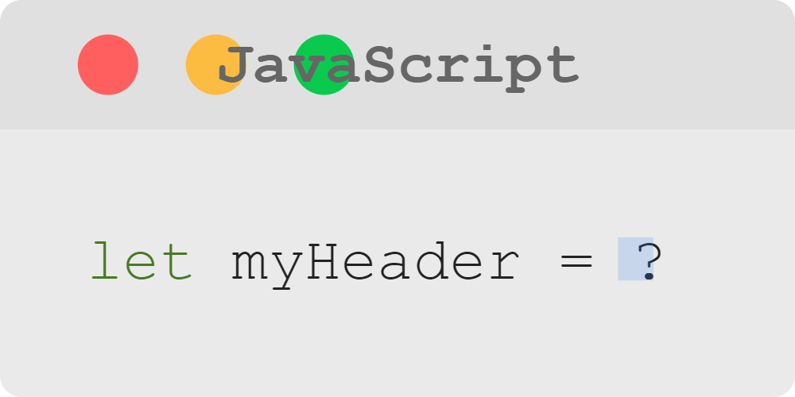
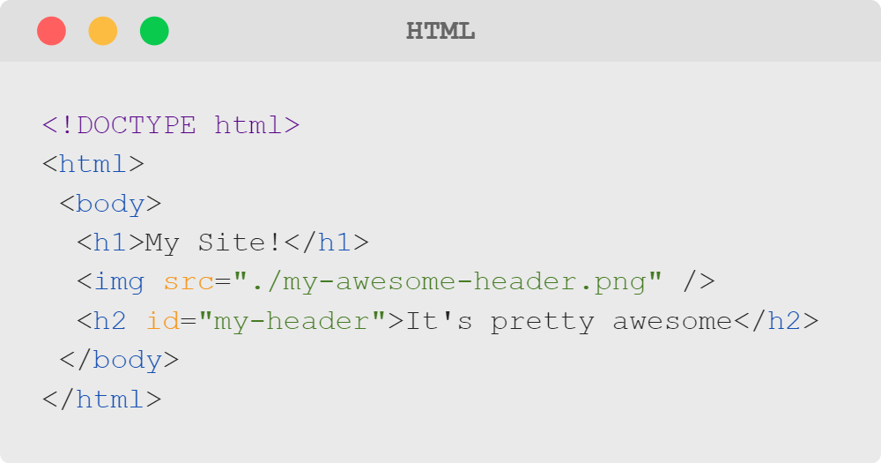
The Document Object Model
Question: Selecting by ID
How would you select the H2 tag by ID?

Slide 14
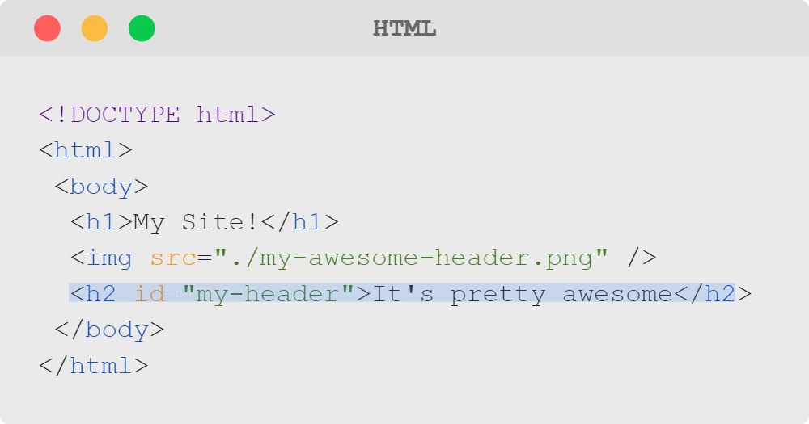
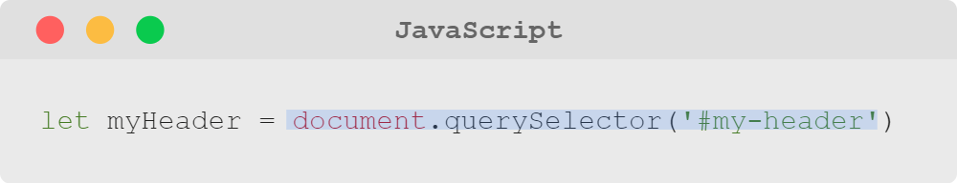
The Document Object Model
Answer
By using the # symbol!

Slide 15


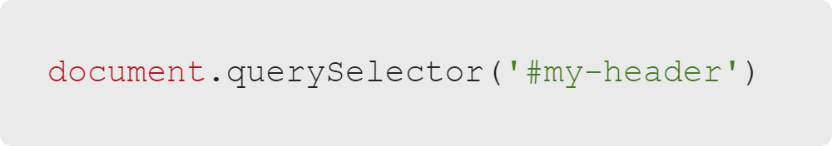
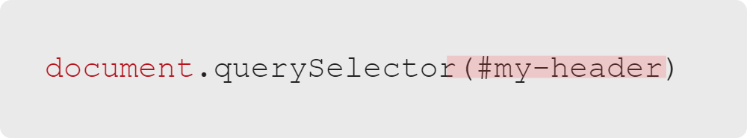
The Document Object Model
Tip: Passing Selectors
This will work.
This will not.

Slide 16
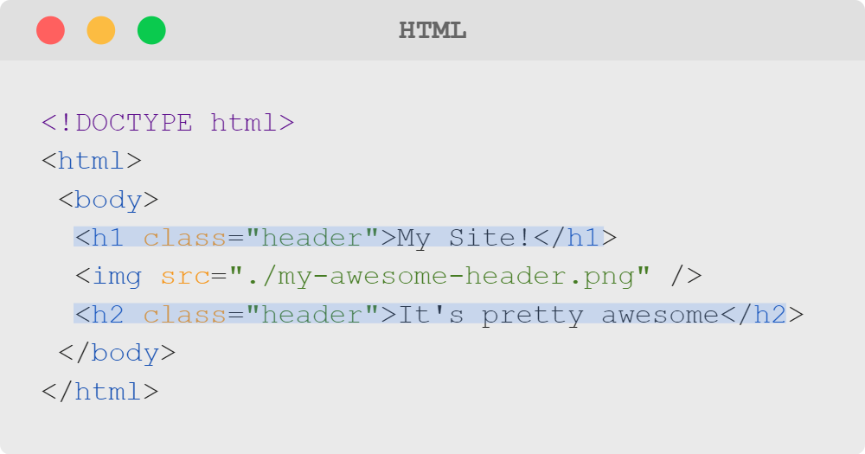
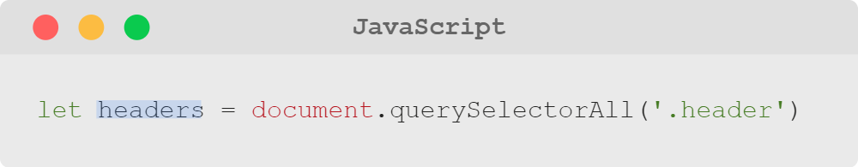
The Document Object Model
Selecting Multiple Elements
Notes:
If you want all the elements that match a specific selector, you can use "querySelectorAll."
It will return an array-like list (called a NodeList) of DOM elements.
<<Exercise 05--select all h1 tags using "querySelectorAll">>

Slide 17
The Document Object Model
CSS and the DOM
The DOM is a large JavaScript object that represents the entire HTML document.
Each HTML element is accessible as a nested property of the DOM. We use methods like querySelector to access them.
Each element has a style property allowing you to access and set CSS properties.
We covered CSS concepts earlier in this course, but let's discuss how CSS applies to the DOM.
Notes:
In the following slides, we will discuss how to access an element's CSS property names
and set CSS property values.

Slide 18
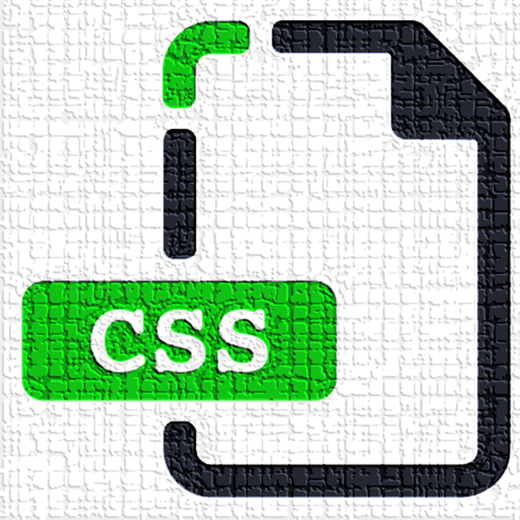
The Document Object Model
Using the .style Property
DOM elements have many properties.
style is an object that represents CSS rules.
It allows us to change the CSS properties of a specific element.
Notes:
DOM elements have many methods and properties. Use documentation (W3Schools, Mozilla, etc.)
when trying to do something specific.
One property you can accomplish quite a bit with is ".style."
Changing the properties of a style object will change the CSS for a specific element.

Slide 19
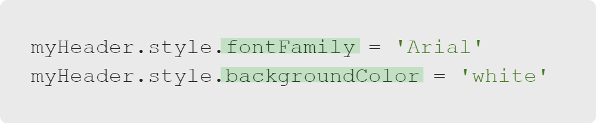

The Document Object Model
Property Names and Values
You can use any CSS property.
You can use any CSS property value (e.g., Arial).
BUT
BUT
It must be written in camelCase!
It must be expressed as a string (e.g., 'Arial')
Notes:
You can use any CSS property name, but it must be written in camelCase because JavaScript
doesn't support using dashes inside variable names.
Note: If you forget to use a string for the property value, you will get an error!
<<Exercise 06--change the background color of a header>>
<<Exercise 07--change the text color of a header>>
<<Exercise 08--change the font family of a header>>

Slide 20
The Document Object Model
Summary
What We've Covered:
The Document Object Model
HTML and the DOM
Defining the DOM
Using and Traversing the DOM
Using querySelector and querySelectorAll
CSS and the DOM
CSS Property Names and Values in the DOM
Let's practice modifying HTML with JavaScript.

